Slide 1
Bright Coffee Shop Analysis
NDIVHUDZANNYI TSHIBALO, 2025/10/31

Slide 2
CONTENTS
INTRODUCTION
AIM
FOCUS
ANALYSIS BREAKDOWN
CONCLUSIONS AND RECOMMENDATIONS
QUESTIONS AND ANSWERS

Slide 3

INTRODUCTION
This analysis is based on the Bright Coffee Shop Sales dataset, which records daily transactions from the coffee shop.
As part of supporting the new CEO’s goal to increase revenue and enhance product performance, this report provides data-driven insights and recommendations derived from historical sales data in the last six months.

Slide 4

2. AIM
The goal of this analysis is to deliver a clear and comprehensive view of Bright Coffee Shop’s performance over the last six months.

Slide 5
3. FOCUS
Product Performance
Store Performance
Marketing Strategy Analysis

Slide 6
4. ANALYSIS BREAKDOWN
Revenue Analysis by Store

Slide 7
Revenue Analysis by Store cont.….
Hell’s Kitchen contributes the largest share of total revenue at 34%.
Astoria and Lower Manhattan generate nearly equal revenue shares, showing balanced performance.
Overall, revenue distribution across stores is consistent, suggesting stable sales patterns across all locations.

Slide 8
Revenue Analysis by Store cont.…

Slide 9
Revenue Analysis by Store cont.….
Steady Monthly Growth:
Revenue shows a consistent upward trend from January through June, with June being the highest-earning month. This indicates increasing customer engagement and possibly seasonal growth in coffee consumption.
Morning Dominates Daily Sales:
The morning period (6 AM – 11:59 AM) generates the highest revenue across all stores. This aligns with customer habits of purchasing coffee and breakfast items before or during work hours.

Slide 10
Revenue Analysis by Store cont.….
Afternoon and Evening Declines:
Sales drop noticeably after midday, suggesting fewer customer visits or smaller purchase volumes later in the day. The night hours contribute minimally to total revenue.

Slide 11
Revenue Analysis by Store cont.…
Business Implication:
Focus marketing and staffing efforts during morning hours and peak months (May–June) to maximize efficiency. Consider promotions or menu adjustments to boost sales during afternoons and evenings.

Slide 12
Revenue Analysis by Store cont.…

Slide 13

Revenue by Store Analysis cont.…
Morning dominates revenue generation
The morning period (6 AM – 11 AM) consistently drives the highest revenue across all store locations, with over 60% of total daily sales occurring during this window.
This reflects strong breakfast and early coffee demand.
Afternoon and evening sales decline gradually
Revenues drop notably after midday, with steady but lower performance during afternoon and evening hours.

Slide 14
Revenue by Store Analysis cont.…
This pattern suggests fewer customers in-store later in the day, possibly due to work schedules or reduced commuter traffic.
Nighttime revenue is negligible
Sales after 8 PM are almost non-existent, implying minimal late-night demand and limited business justification for extended operating hours.
Operational insight
The business could optimize staffing and inventory around morning peaks and explore promotions or delivery options to boost afternoon and evening performance.

Slide 15
Insights on Product Sales

Slide 16

Insights on Product Sales cont.…
Coffee and Tea dominate total sales
Coffee contributes the highest share of total revenue at 38.6%, followed by Tea at 28.1%.
Together, these two categories account for over two-thirds of total sales, highlighting their central role in driving the business.
Moderate performance in Bakery and Drinking Chocolate
Bakery (11.8%) and Drinking Chocolate (10.4%) are strong secondary contributors, performing consistently across all store locations.

Slide 17
Insights on Product Sales cont.…
Low-performing categories
Coffee Beans, Branded Items, Loose Tea, Flavours, and Packaged Chocolate contribute minimally (<6% each), indicating potential underperformance or niche demand.
Business Opportunity
Focus marketing and promotions on Coffee and Tea to maintain strength.
Explore ways to boost sales in lower-performing categories through bundling, sampling, or limited-time offers.

Slide 18
Revenue by Day of Week

Slide 19

Revenue by Day of Week cont.…
Weekday sales are strong and consistent
Revenue remains steady from Monday to Friday, ranging between R99,000 and R102,000.
The highest revenue occurs on Monday (R102,000), possibly due to routine morning commutes or early-week coffee demand.
Slight dip on weekends
Revenue declines on Saturday (R97,000) and Sunday (R98,000), suggesting lower foot traffic or reduced operational hours.
This pattern indicates that weekday business drives the bulk of total revenue.

Slide 20
Revenue by Day of Week cont.…
Operational insight
The business could maintain weekday staffing and inventory levels, while considering cost optimizations on weekends.
Alternatively, weekend promotions (e.g., family combos, brunch specials, or loyalty discounts) could help stimulate demand.

Slide 21
Total Revenue vs Quantity Sold

Slide 22
Total Revenue vs Quantity Sold
May and June recorded the highest sales and quantities sold, with June leading overall performance.
This trend aligns with the winter season, when colder weather drives increased consumption of coffee and tea as customers seek warmth.
Overall, revenue and sales volumes remained stable across the six-month period, indicating consistent customer demand throughout the year.

Slide 23

Conclusions and Recommendations For Bright Coffee Shop
Focus on Peak Months
May and June show the highest sales — leverage this by launching seasonal winter promotions (e.g., “Winter Warmers” coffee and tea specials).
Consider stocking up on coffee and tea supplies ahead of winter to meet higher demand.
Enhance Morning Operations
The morning period generates the most revenue across all stores.
Improve morning service efficiency, staffing, and product availability to maximize sales during these crucial hours.

Slide 24
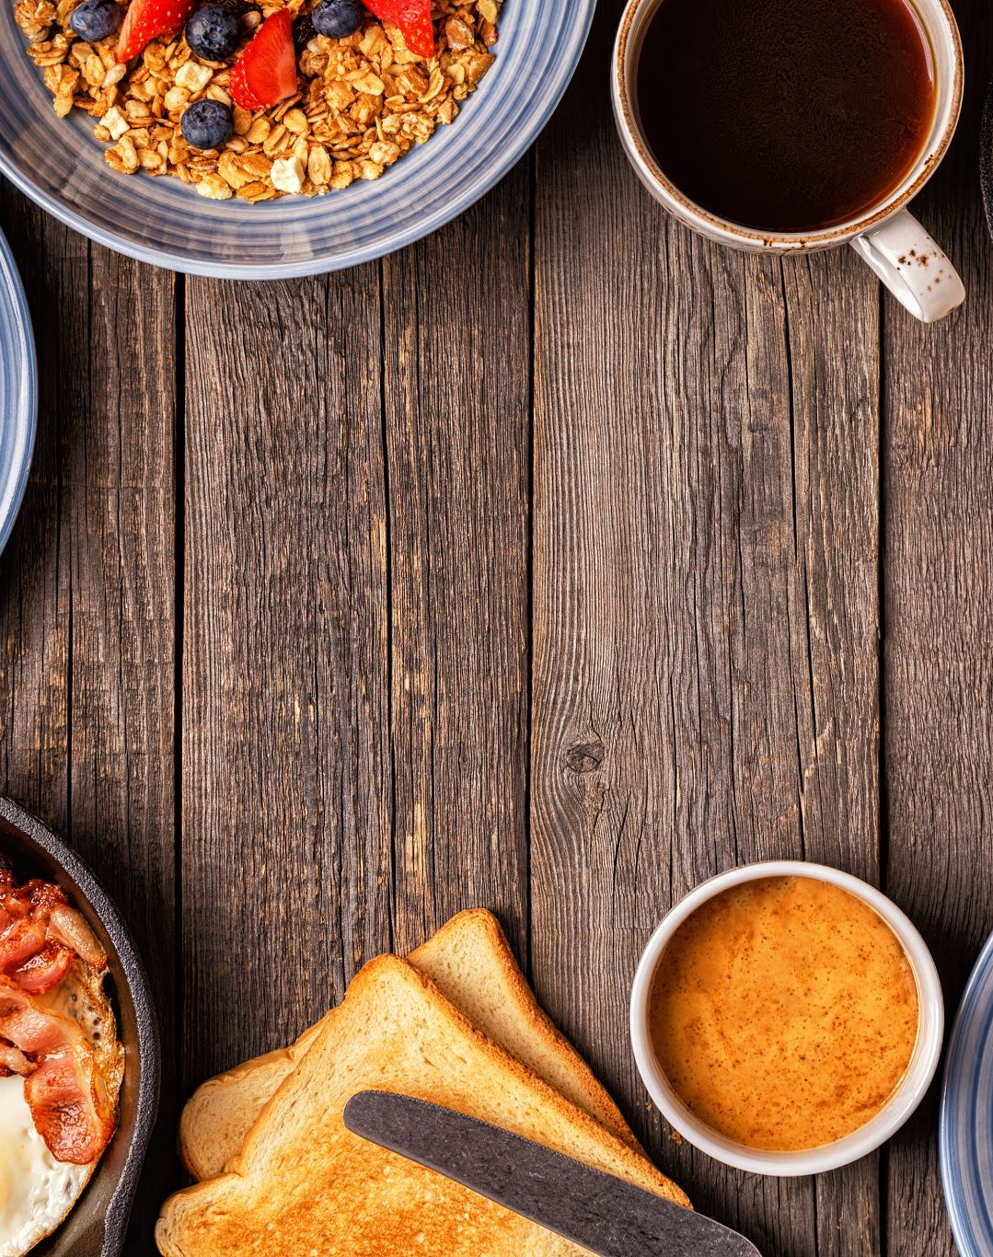
Conclusions and Recommendations For Bright Coffee Shop cont.…
Introduce breakfast combos or loyalty rewards for early customers.
3. Optimize Store Performance
Hell’s Kitchen leads slightly in total revenue, but Astoria and Lower Manhattan show comparable performance.
Use best practices from the top-performing store (e.g., promotions, layout, customer flow) and apply them across all locations.
Explore localised marketing to attract nearby office workers and commuters.

Slide 25
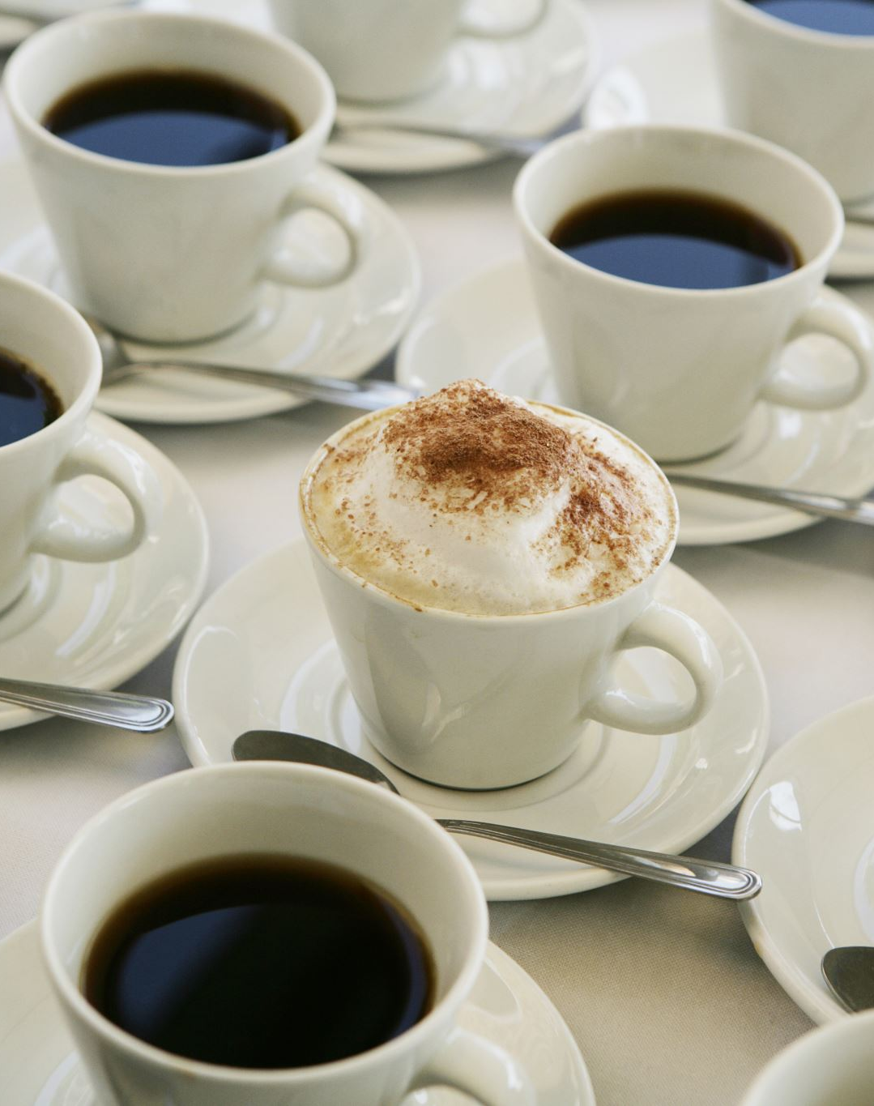
Conclusions and Recommendations For Bright Coffee Shop cont.…
5. Expand High-Performing Product Lines
Coffee and Tea contribute over 65% of total revenue, prioritize them in marketing campaigns and seasonal menus.
Upsell bakery items and drinking chocolate, which have solid secondary performance, especially during colder months.
Evaluate low-performing products (e.g., packaged chocolate, loose tea) for menu optimisation or bundling opportunities.
5. Maintain Weekday Consistency
Revenue remains stable across weekdays, with a slight dip on weekends.

Slide 26
Conclusions and Recommendations For Bright Coffee Shop cont.…
6. Data-Driven Growth
Continue tracking hourly and daily sales trends to fine-tune staffing, inventory, and promotions.
Use insights from sales data to forecast demand and improve decision-making for upcoming quarters.

